Slide 1
FORMALITIES FOR SETTING UP OF A SMALL BUSINESS ENTERPRISE/ Industrial unit

Slide 2
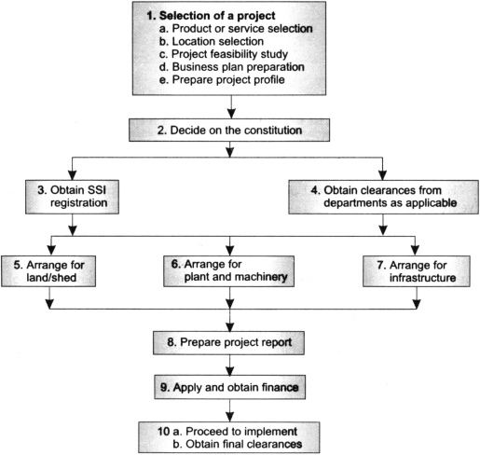
1.
2.
3.
4.
5.
6.
7.
8. .
9.
10 .

Slide 3
1. Selection of a Project

Slide 4
An entrepreneur has to prepare a business plan.
Depending on the type of project, location, investment involved, and so on, the entrepreneur has to proceed to take further steps in establishing the unit.
Project selection and preliminary activities involve the following.
Product or service selection
Location selection
Project feasibility study
Business plan preparation
Preparation of a project profile

Slide 5
(a) Product or Service Selection
The main factors are as follows.
Background and experience of the entrepreneur(s)
Availability of technology and know-how for the project
Marketability of the product/service
Investment capacity
Availability of plant and machinery
Availability of raw materials
Availability of proper infrastructure facilities (land/shed, power, water, transport, and so on).

Slide 6
(b) Location Selection
The location of the project—where to set, the unit.
Proximity to market;
Availability of raw materials;
Availability of transportation and communication facilities;
Availability of incentives/concessions;
Government policy;
Availability of suitable infrastructure facilities; and
Convenience for the promoter.

Slide 7
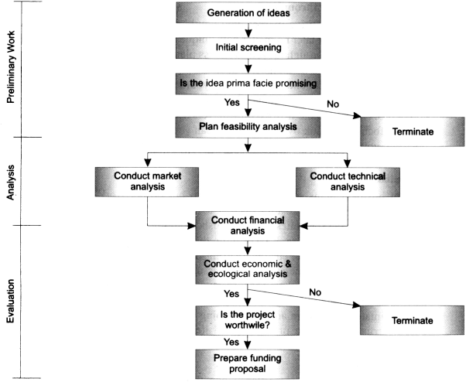

Slide 8
(d) Business Plan Preparation
Written documents
An organized and effective response to a situation which may arise in future.
Not only for start up firm but also growing firm
To establish realistic goals or targets to achieve and to determine the current position.
To help make crucial start-up decisions; to reassure lenders, investors or backers; to measure operational progress; to test planning assumptions; to adjust forecasts; and to set the standard for good operational management.

Slide 9
(e) Project profile
A project profile gives a bird's-eye view of the proposed project.
This may be used for obtaining the Provisional Registration Certificate (PRC) from the District Industries Centre and for making, applying for Industrial Areas Development Board for land or State Small Industries Development Corporation (SSIDC) for shed and other infrastructures.

Slide 10
2. Decide on the Constitution

Slide 11
In India setting up a private limited company is the most popular choice among entrepreneurs.
To start an industry, the promoter(s) have to decide on the constitution of the unit. There are five major alternatives.
Sole proprietorship
Partnership
Corporation/Limited company
Cooperative
Franchising

Slide 12
3. Registration

Slide 13
Obtain SSI Registration
Small-scale and ancillary units that is undertakings with investment in plant and machinery of less than Rs 1 crore) should seek registration with the Director of Industries of the concerned State government.
Process
Unit goes into production
The provisional registration certificate (PRC) has to be converted into a permanent registration certificate (PMC).

Slide 14
Registration Formalities
Prescribed court fee stamp
Copy of the project profile
Partnership deed/Memorandum and Articles of Association, as the case may be
Affidavit, as per format on appropriate stamp paper
The initial validity of the PRC is for two years and it can be renewed subsequently, if needed.

Slide 15
4. Clearances from Specific Departments

Slide 16
Clearance of Specific Department
Agricultural land conversion
Urban land ceiling clearance
Building plan approval
Factories Act
Trade licence
Pollution Control Board clearances
GST registration
Bureau of Indian Standards (BIS) certificate
Fruit Products Order (FPO) licence
Food Adulteration Act licence
Power loom registration
Electronics industries registration
Drugs and cosmetics licence
Approvals of hotels
100 per cent export-oriented unit

Slide 17
5. Arrange for Land/Shed

Slide 18
Industrial Land
Once the location of the unit is decided, the land for the project could be conveniently taken from the State Industrial Areas Development Board.
Private land could also be purchased, but it has to be converted for industrial purpose and other necessary legal/formalities will have to be completed.
Industrial shed
For setting up an SSI unit, the promoters could consider using a ready industrial shed. This could be on rent or on ownership basis.

Slide 19
6. Arrange for Plant and Machinery

Slide 20
Two type of Purchase
Direct purchase (Purchased from recognised manufacturers/dealers)
Hire Purchase ( scheme operated by the National Small Industries Corporation (NSIC))

Slide 21
7. Arrange for Infrastructure

Slide 22
Land and Construction of Building
Availability of basic amenities like power, water
Connectivity to nearest rail, road, or port
Price of the land
Getting the Utility Connections
Water Supply
Power Supply

Slide 23
8. Prepare Project Report

Slide 24
The project report gives a detailed insight of the project and indicates the techno-economic viability of the project.
GENERAL POINTS
Expected use of the project report
Elaborate details but retaining the confidential data
Proper validation of the data and information based on reliable sources
Effective presentation by use of charts, graphs, and pictorial forms
Cost minimization and timeliness
Proper estimation of the requirement of number of copies

Slide 25
9. Apply and Obtain Finance

Slide 26
Means of Finance
Own equity
Internal accruals
Inter corporate deposits/investment
State financial institutions
Other financial institutions
Banks
Other borrowings like ECB, CP, FDI, FCNRB
State subsidy and seed capital
Lease finance
Small-scale units can obtain finance for their projects under two main categories.
Term loan
Working capital loan

Slide 27
Arranging Finance
Small Industries Development Bank of India (refinance and direct lending)
State Financial Corporations, for example, Delhi Financial Corporation and Gujarat State Financial Corporation
National Small Industry Corporation
Small Industry Development Corporations of various States
Commercial/cooperative banks
District Industry Centre
In addition, large term loans are also available from all-India financial institutions such as IDBI, IFCI, and ICICI.
The Export Import Bank of India and Export Credit and Guarantee Corporation are Central agencies which provide credit for export/import and EXIM guarantees respectively.

Slide 28
10. Implement the Project and Obtain Final Clearances

Slide 29
1. Construct Shed
If the entrepreneurs have taken a readymade shed from the State Small Industries Development Corporation or have made arrangements for rental sheds/premises, then they need not go through this step.
But not then concerned authorities like the municipal corporations or municipalities or village panchayats.
Order for Machinery:
Recruit Personnel:
Arrange for Raw Materials:
Marketing:
Erection and Commissioning:
Obtain Final Clearances:

Slide 30
Regulatory or Taxation Clearances
Registration under Sales Tax Act—Commercial Tax officer of the area concerned.
Registration under Central Excise Act—Collector of Central Excise or his nominee.
Payment of Income Tax—i TO of the area concerned.
Registration of Partnership deed—Inspector General of area concerned.
Calibration of weights and measures—Weights and Measures Inspector of State.
Power connection—designated officer of State Electricity Board.
Employee strength exceeding 10 with power connection, or 20 without power – Chief Inspector of Factories.

Slide 31
ENVIRONMENT POLLUTION RELATED CLEARANCES
Pollution control:
Industries requiring water and affecting effluent disposal:
For units functioning outside the industrial area:
Registration and licensing of a boiler:
For registration as a 100 per cent export-oriented unit (EOU)

Slide 32
Product Specific Clearances
Establishing a printing press—District Magistrate.
License for cold storage construction—designated official in State.
Pesticides – Central/State Agricultural Department—Ministry of Agriculture.
Drugs and pharmaceuticals—drug licence from State Drug Controller.
Safety matches/fireworks—licence under Explosives Act from Directorate of Explosives, Nagpur.
Household electrical appliances—licence from the Bureau of Indian Standards.
Wood working industry within 8 km from forest—District Forest Officer.
Milk processing and milk products manufacturing units-approval under Milk and milk Products Order from State Agricultural/Food Processing Industries Department above a designated capacity.

